Slide 1
Data visualization activities: Teaching and learning how to become better consumers and communicators of data
Katie Fitzgerald
Azusa Pacific University
MathFest
4 August 2023

Slide 2
Learning Goals
Critical consumers of data / evidence
data literacy
Effective communicators (of data / evidence)
Effective givers and receivers of constructive feedback

Slide 3
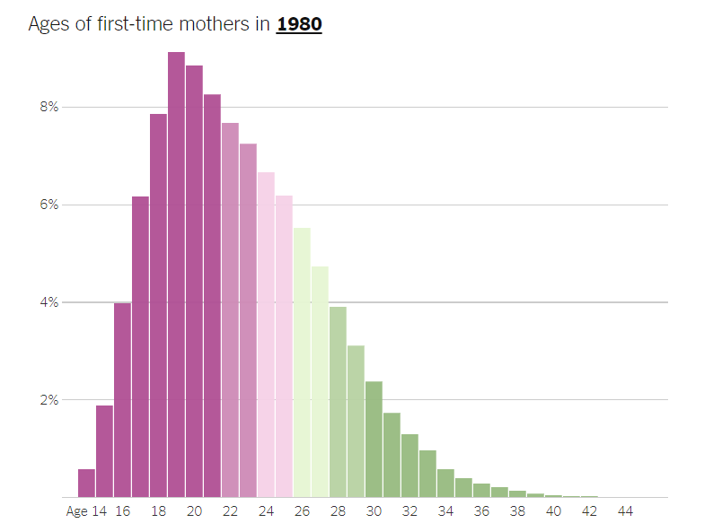
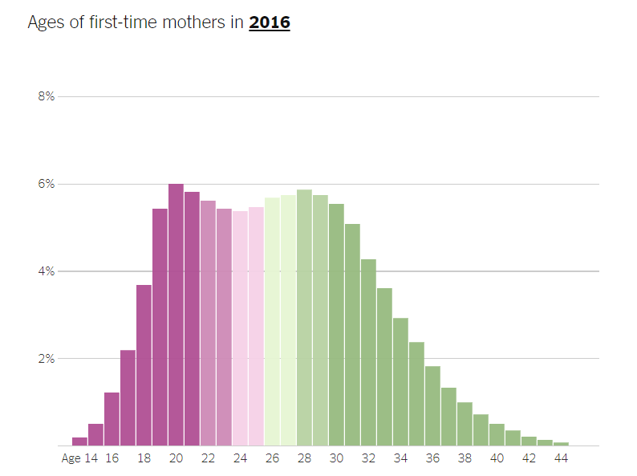
What’s Going On In This Graph? (NYT)
What do you notice?
What do you wonder?

Slide 4
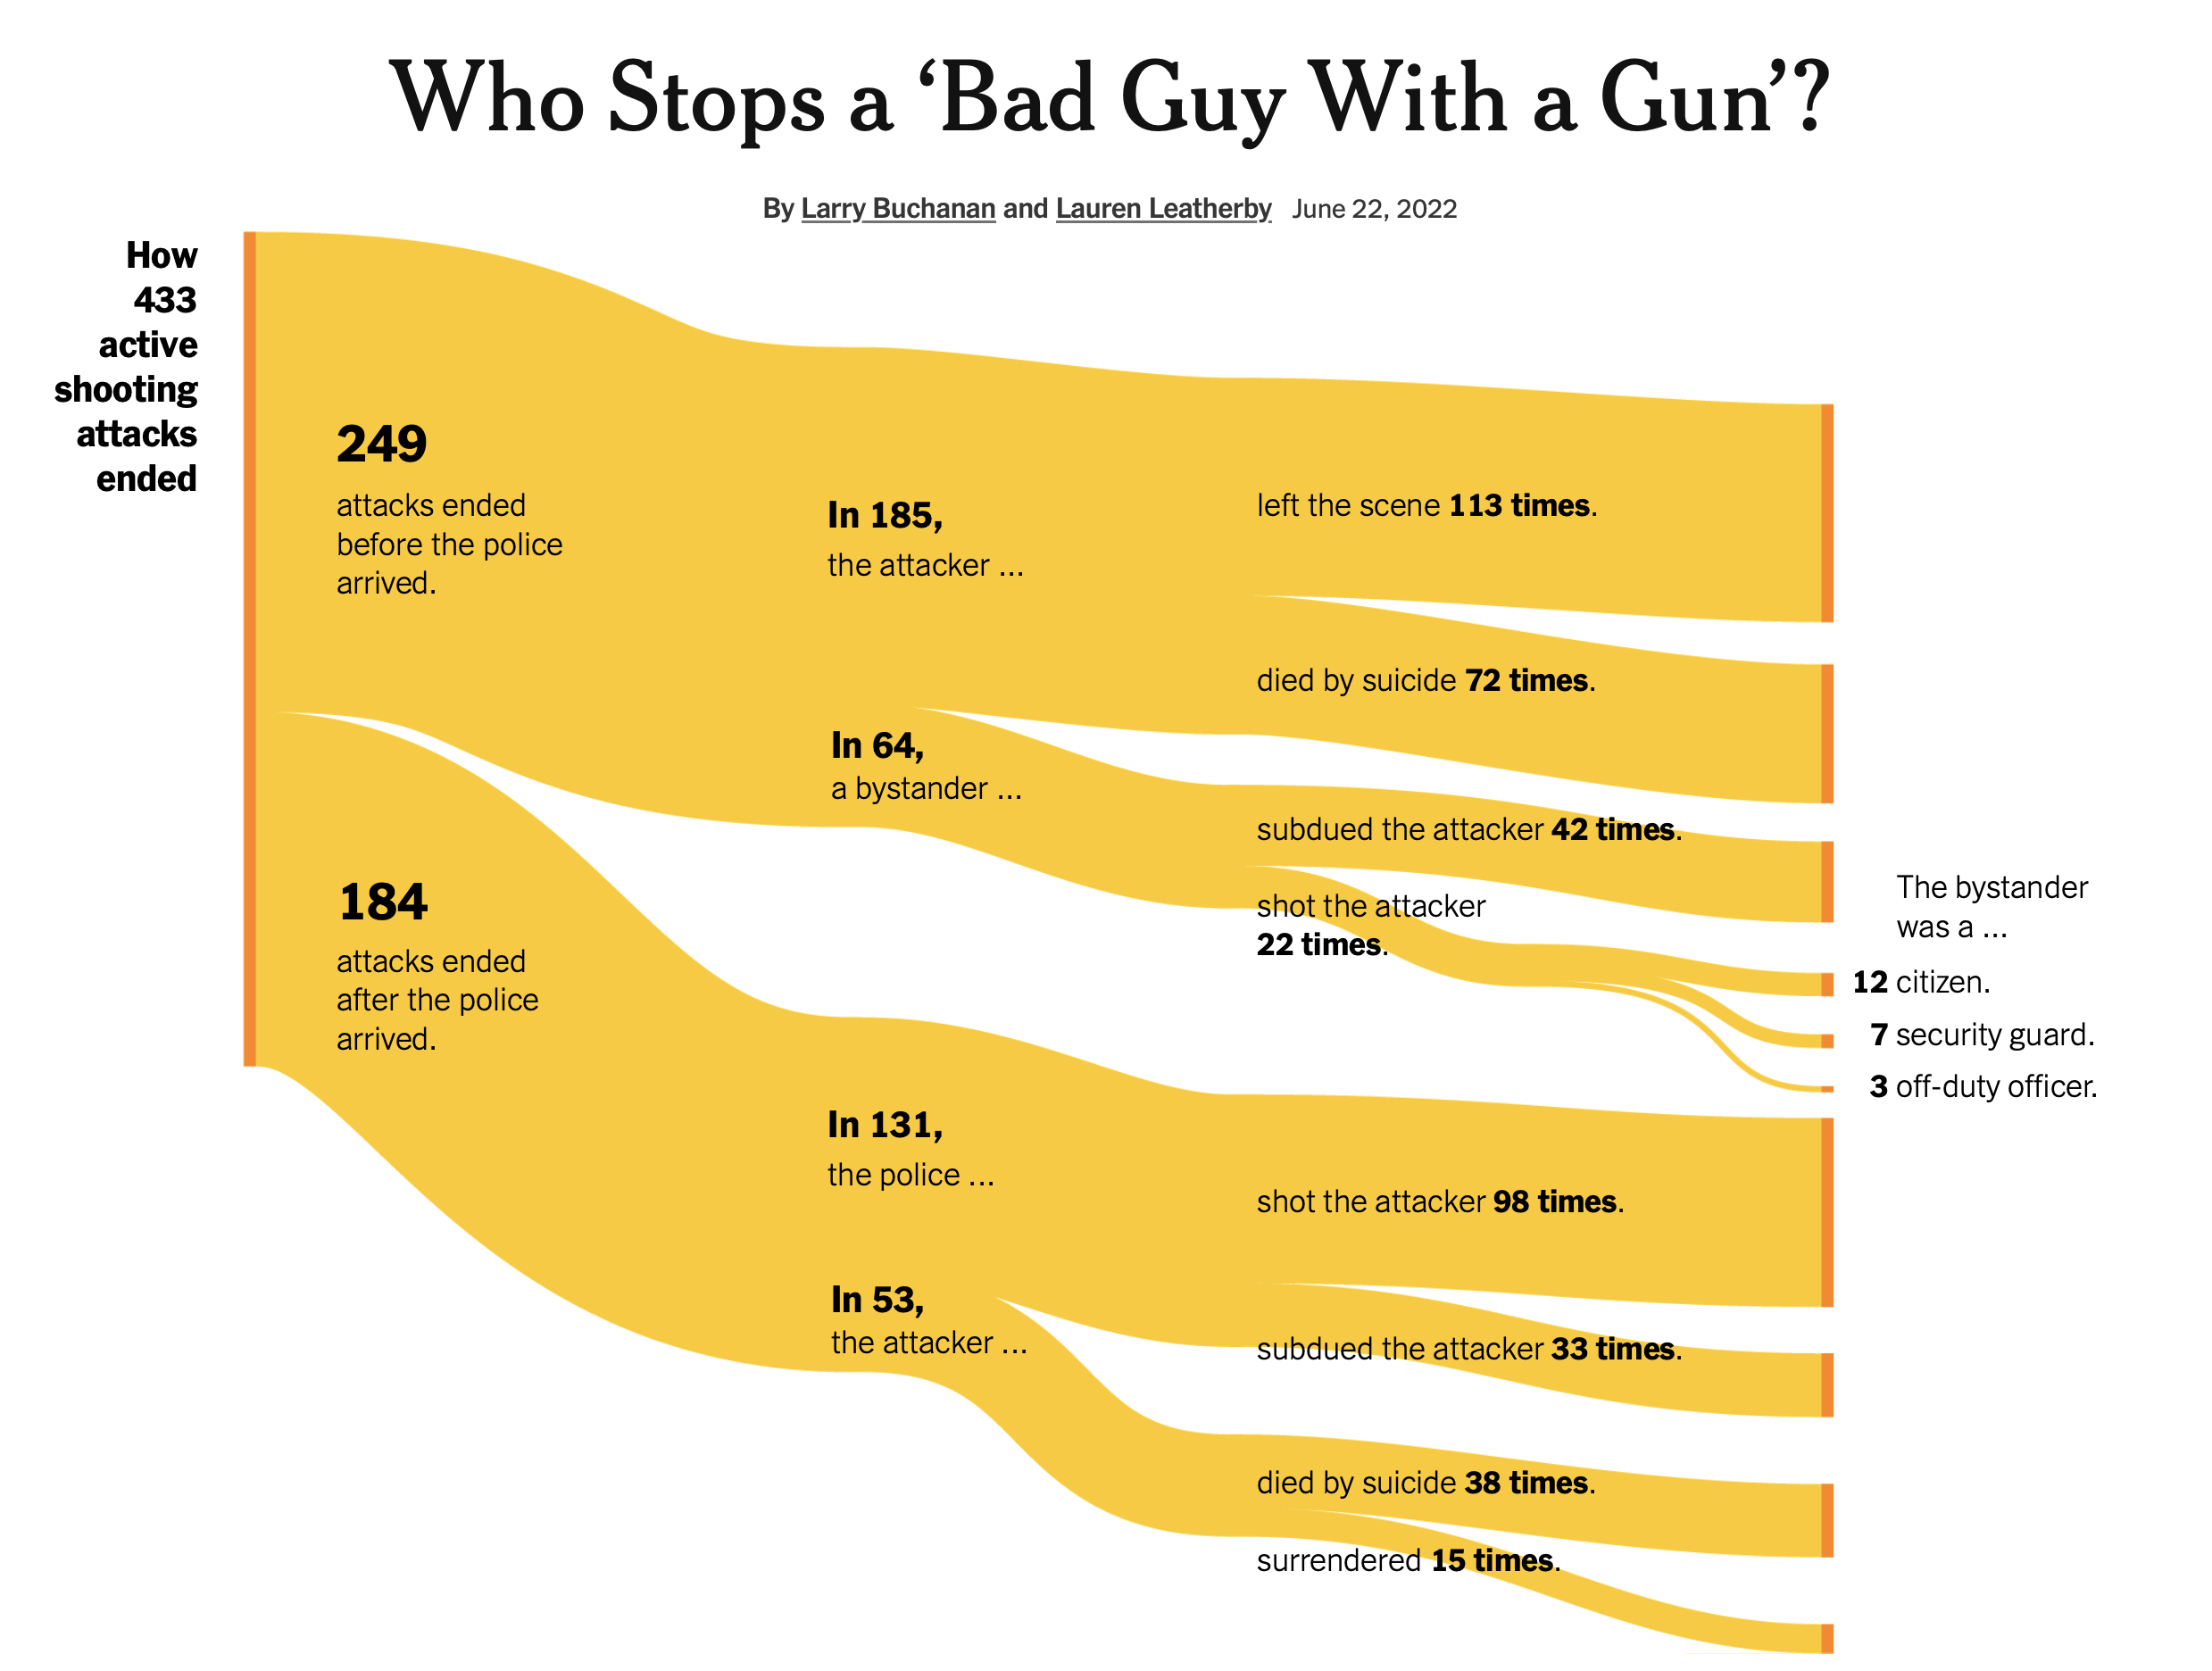
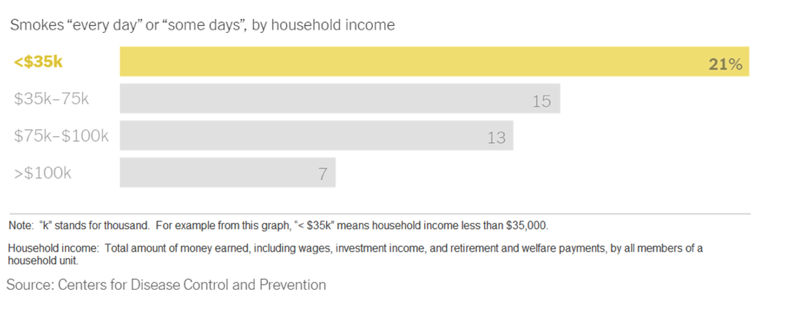
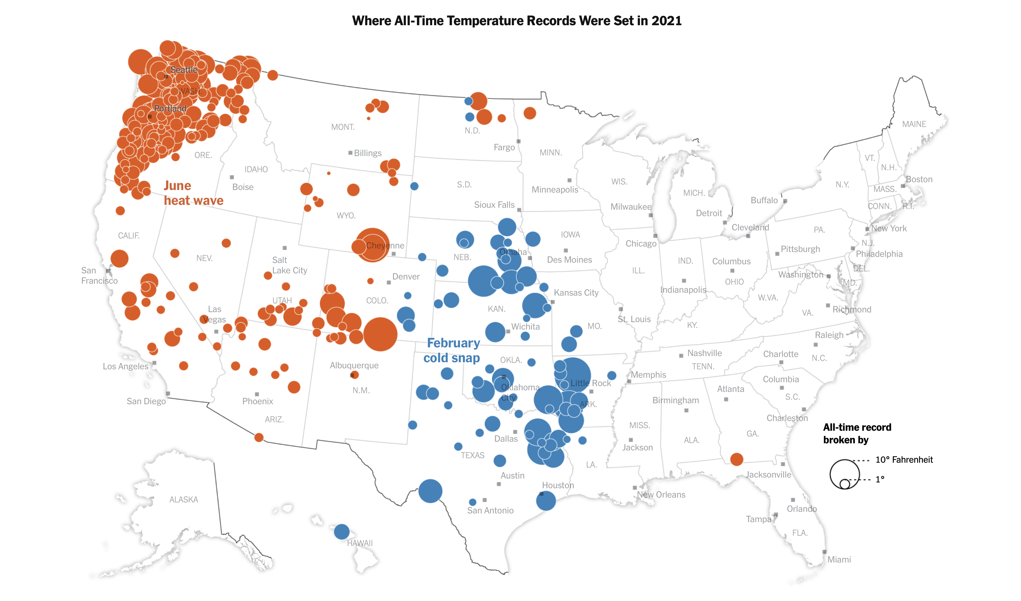
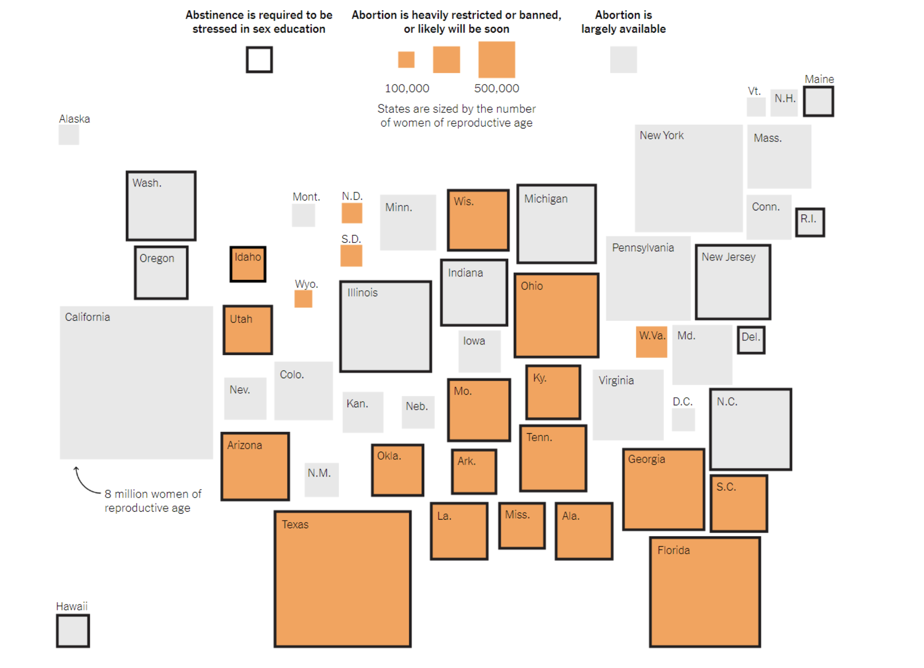
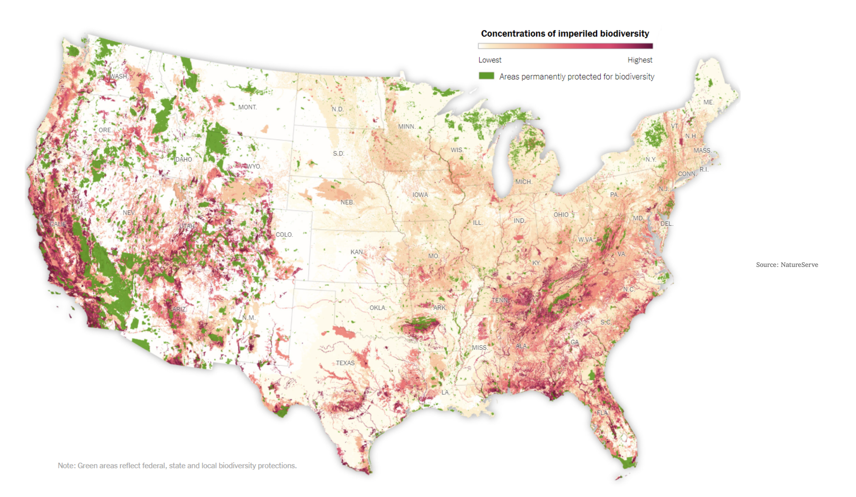
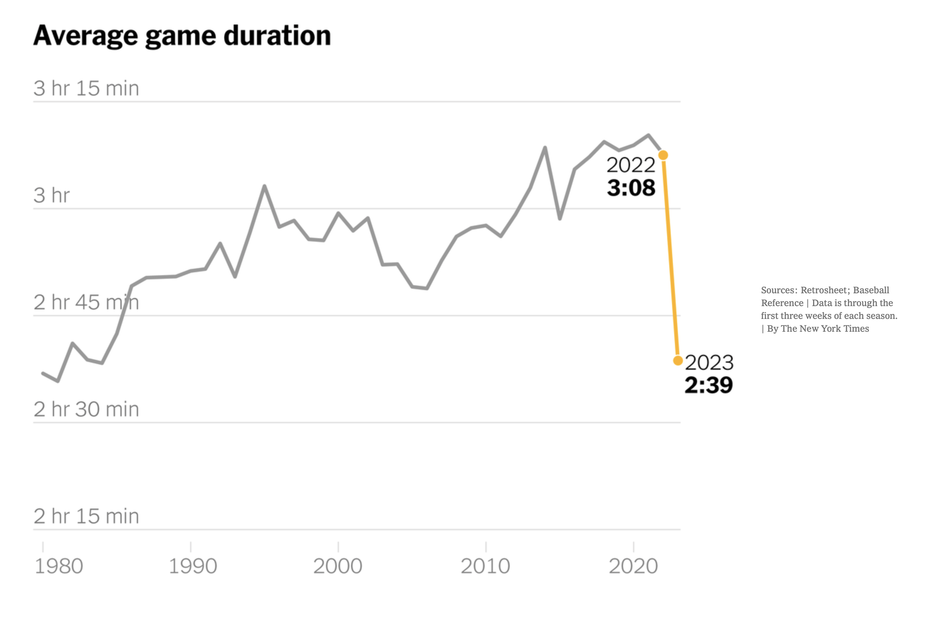
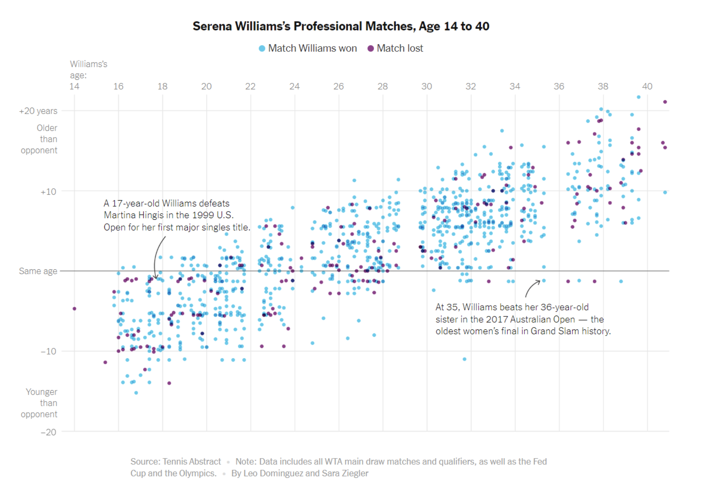
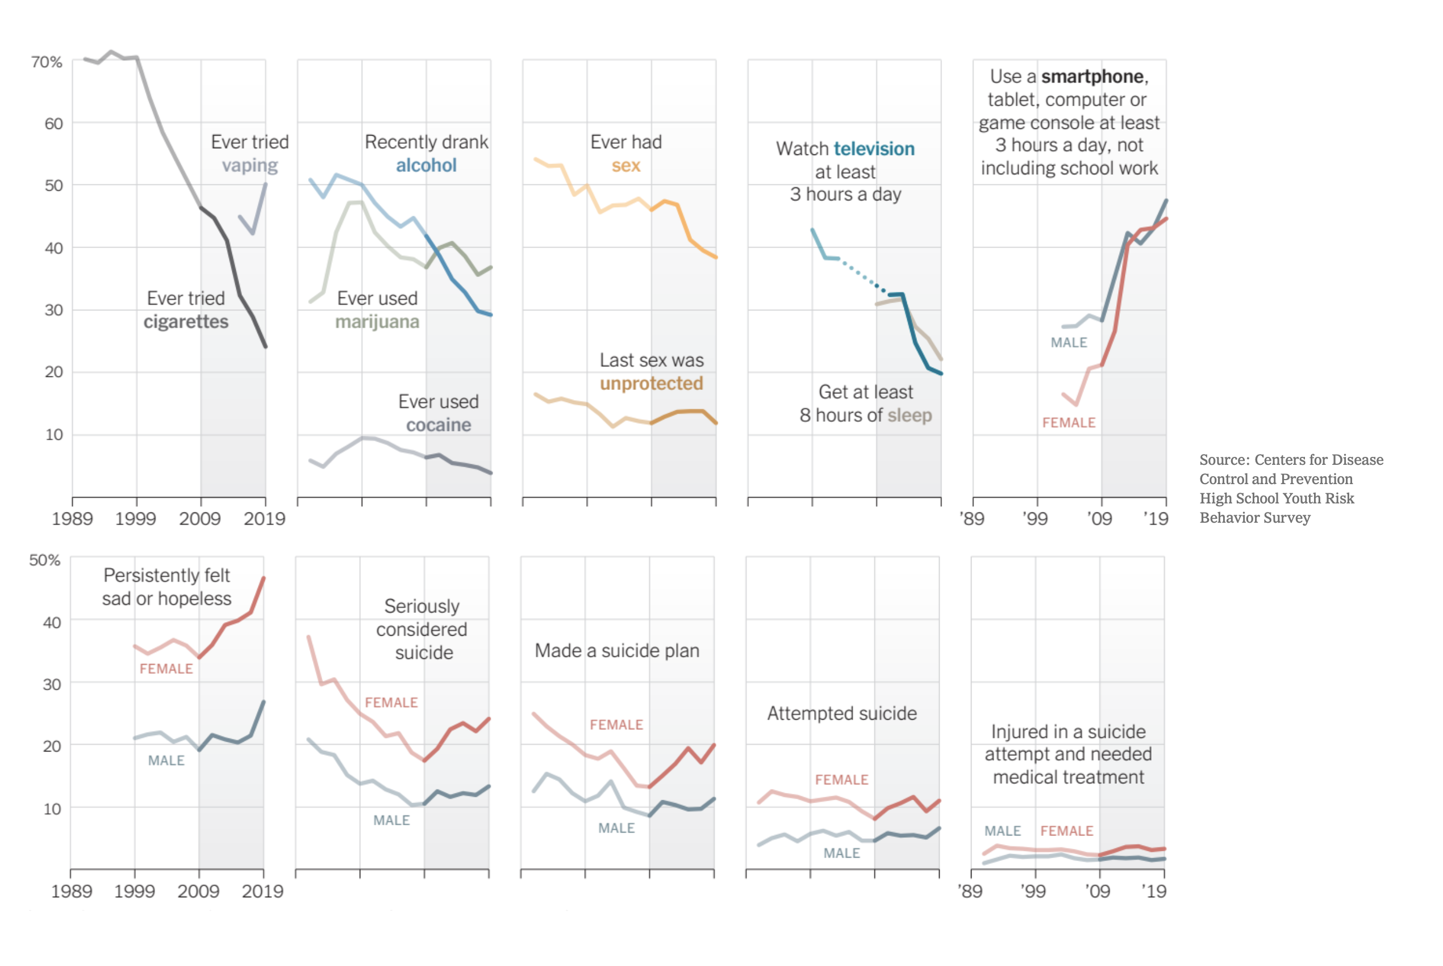
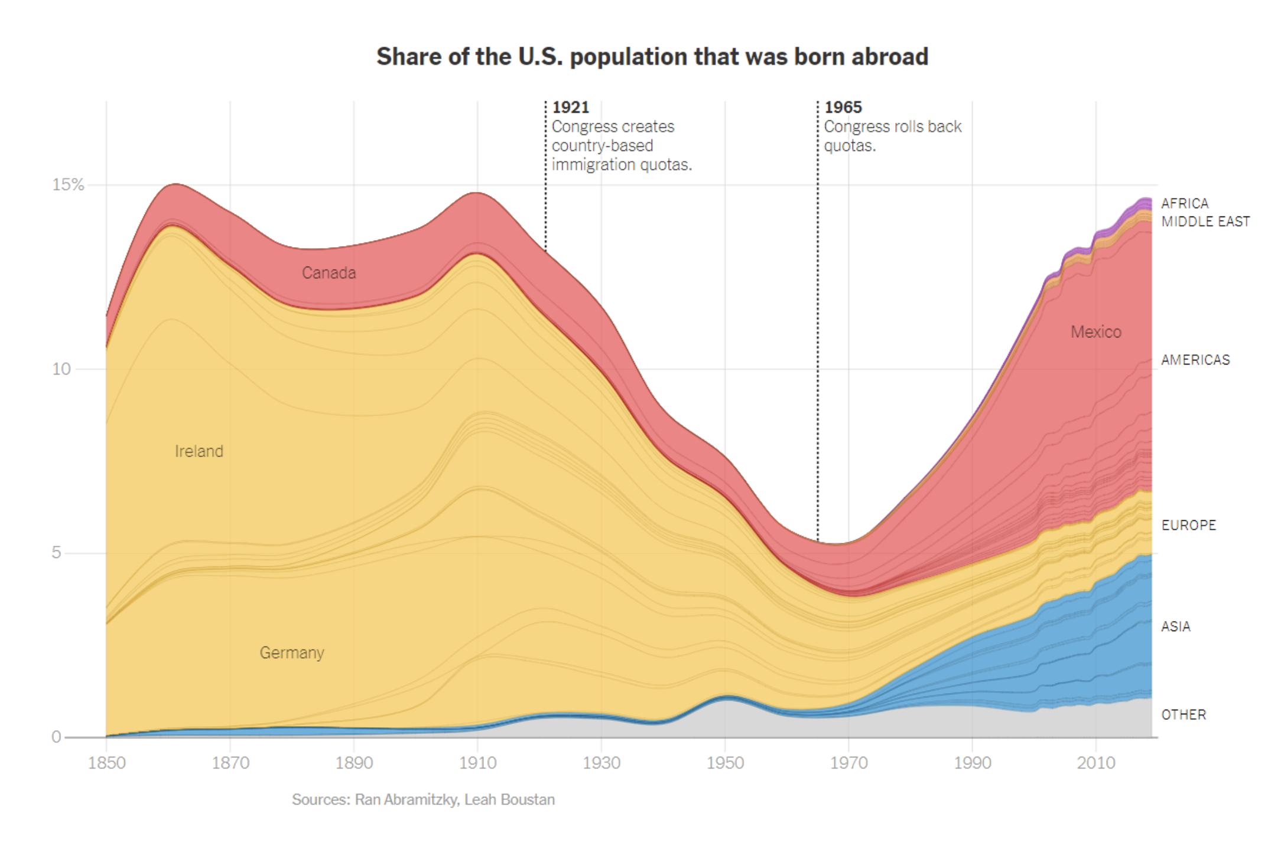
Exposure to (broad) applications of statistics
Practice identifying observational units and (types of) variables
Exposure to broad range of data visualizations
Practice being critical consumers of data
Help them see themselves in the data (and notice who is missing)

Slide 5
Common problem: data communication
I have data / evidence
I need to communicate it
Thesis: Cognitive science can help

Slide 6
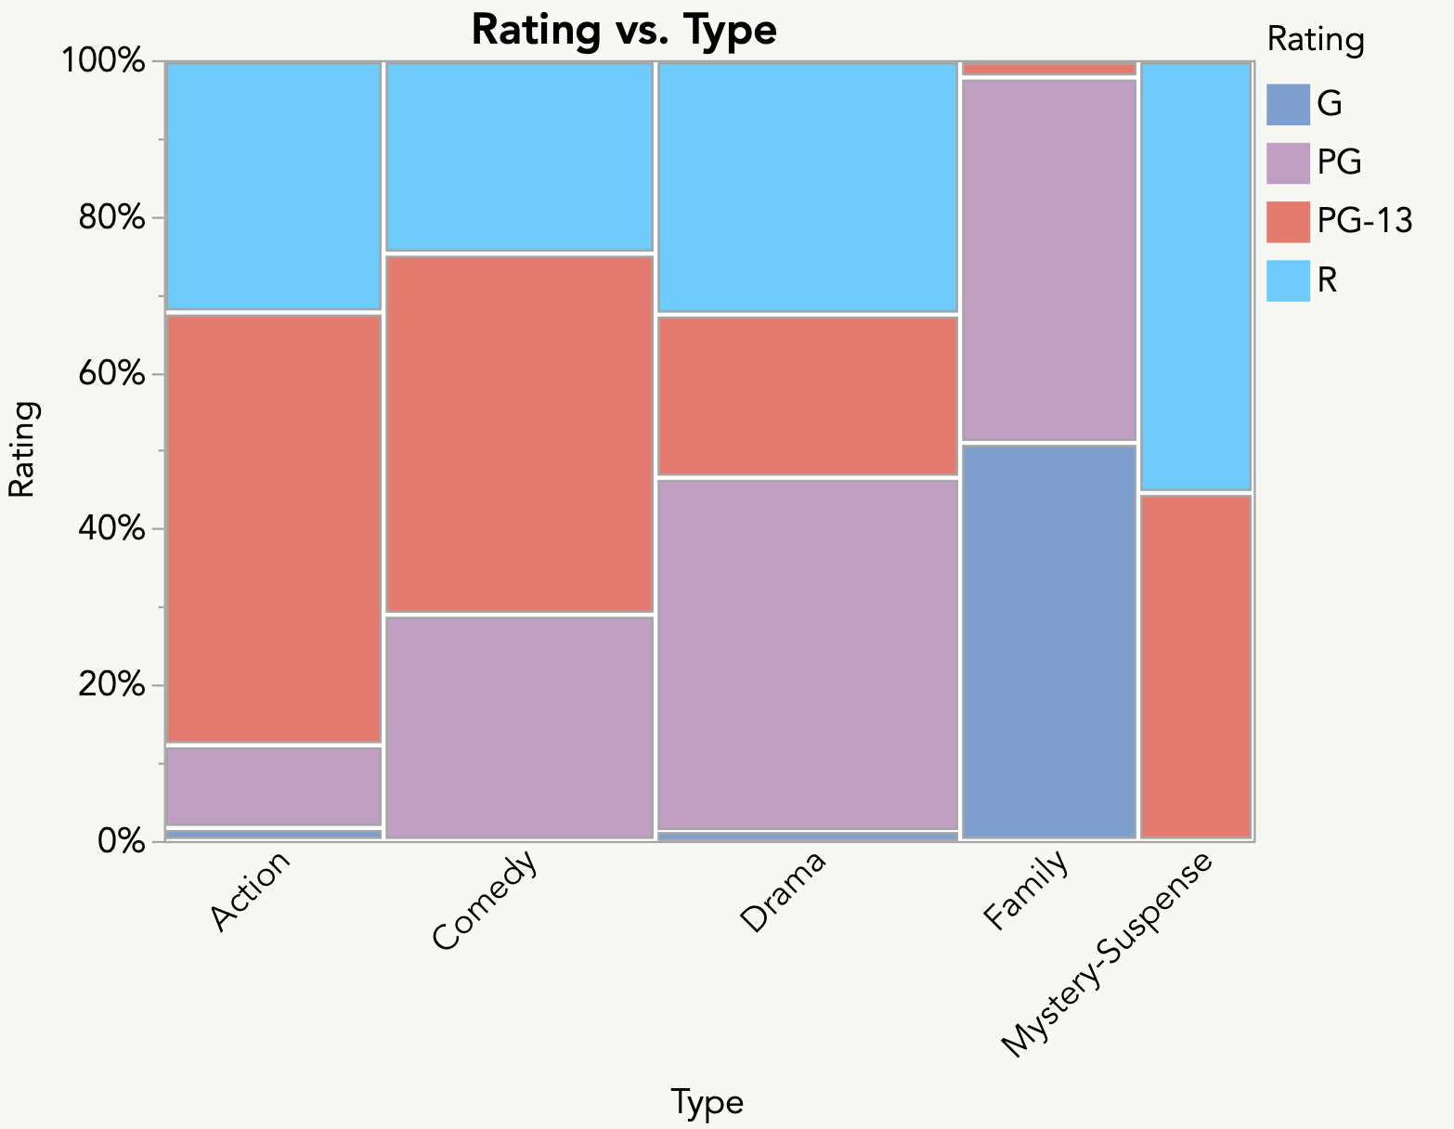
What rating is more common in Drama movies: PG-13 or R?
From Ross Metusalem

Slide 7
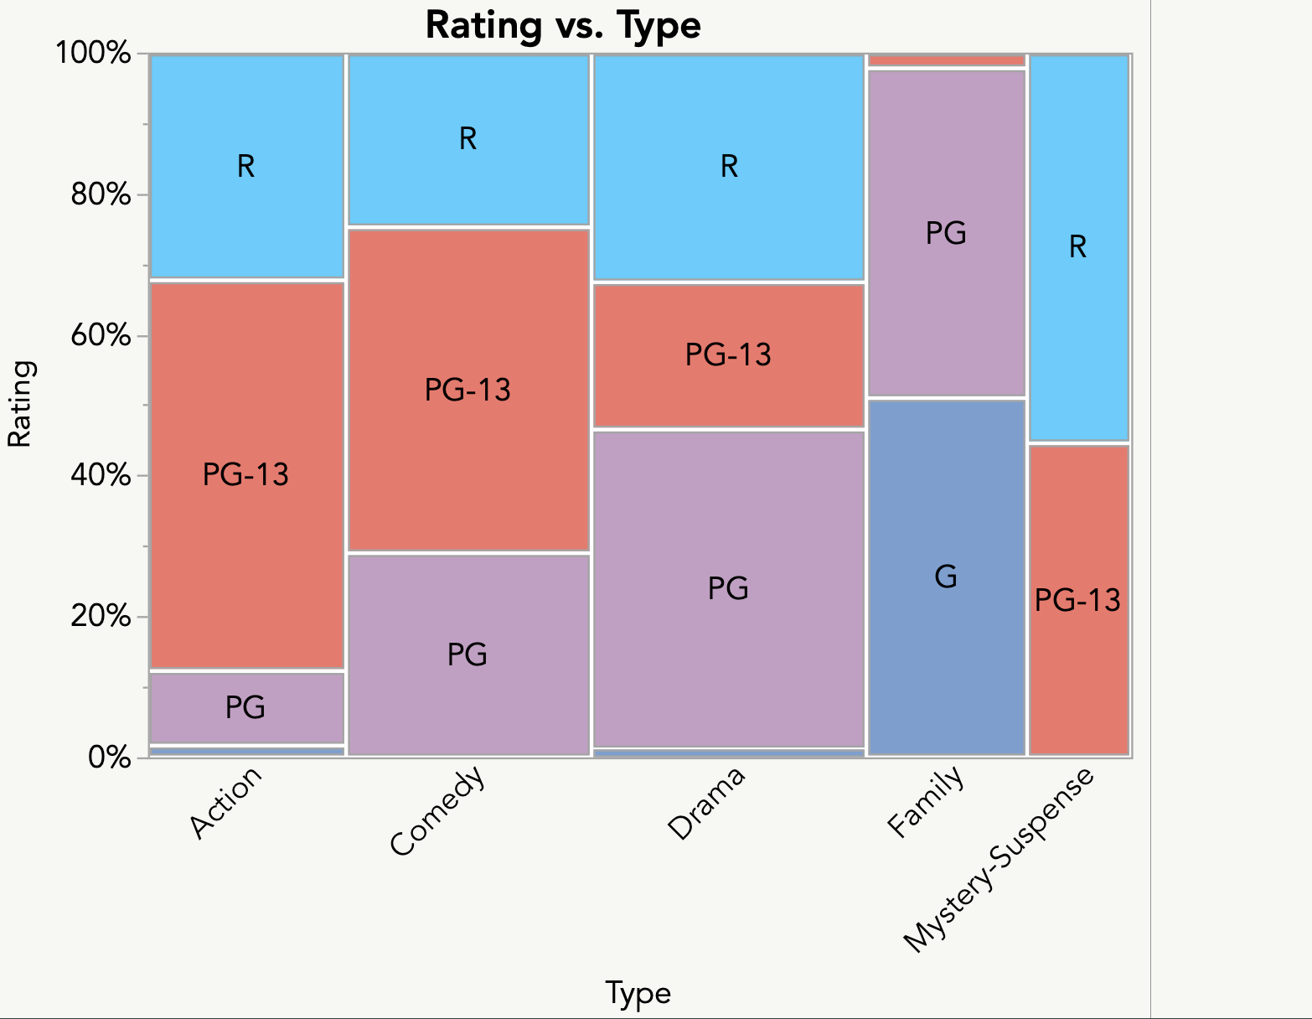
What rating is more common in Drama movies: PG-13 or R?
Data vis tips:
#1: Reduce cognitive load
#2: Label directly
From Ross Metusalem

Slide 8
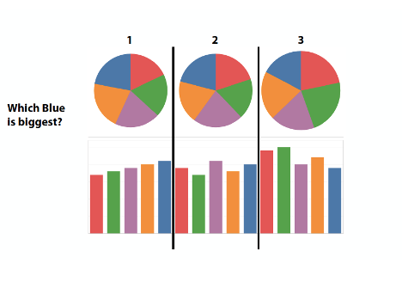
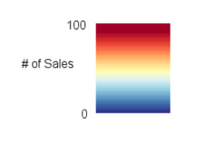
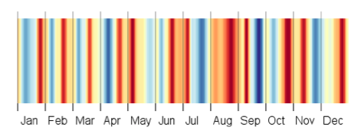
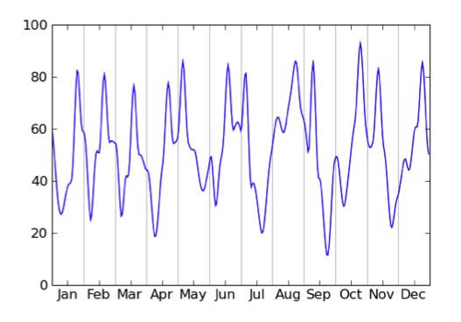
Different visualizations can tell different stories
(even about the same data!)
Corell, M., Albers, D., Franconeri, S., Gleicher, M. (2012).
Data vis tips:
#1: Reduce cognitive load
#2: Label directly
#3: (Positional) encodings
#4: Salience matters
Every visualization shows some info and hides others. What do you want (your audience) to see?
Notes:
What month had the day with the highest # of sales? - easier to see on the top graph (harder to discern the “reddest red”)
What month had the highest average # of sales? - easier to see August is darkest on the bottom graph (harder to perceive averages on line graph)
Courtesy of Steve Franconeri

Slide 9
Class Activity
Sketch two visualizations that highlight different comparisons of these data.
They should produce different sentences (stories) in your head.
Category | Year 1 | Year 2
A | 15% | 39%
B | 35% | 8%
C | 26% | 25%
D | 24% | 28%
Inspired by Steve Franconeri, Zelanzy (1950)

Slide 11
Grouping in space guides comparison
Data vis tips:
#1: Reduce cognitive load
In year 1,
B > A,
C = D
#2: Label directly
#3: (Positional) encodings
#4: Salience matters
In A,
Year 1 < Year 2
#5: Grouping matters

Slide 12
Feedback makes us better! “I like” and “I wish”

Slide 13
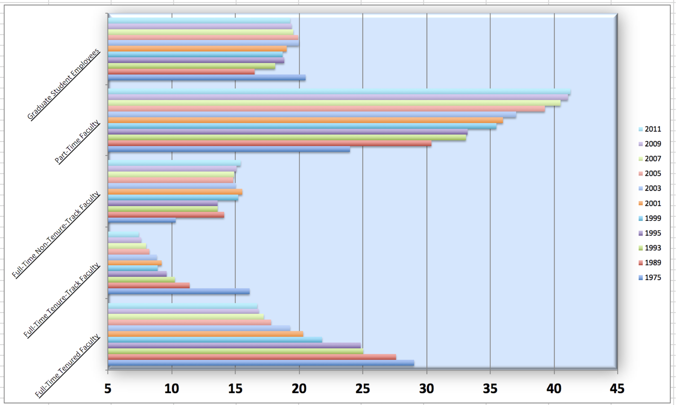
Take a sad plot, make it better
Objective: show that the proportion of part-time faculty has gone up over time compared to other instructional staff types.
From datasciencebox.org

Slide 14
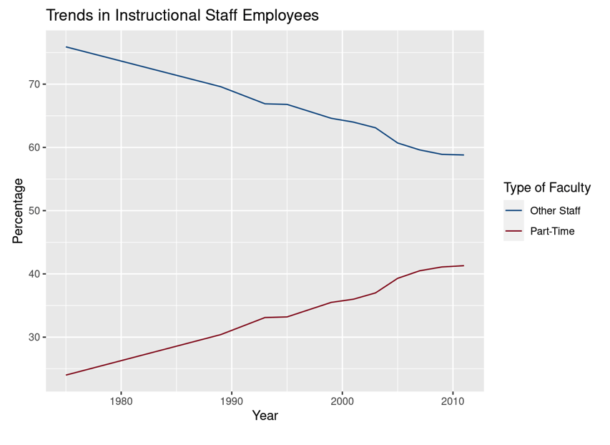
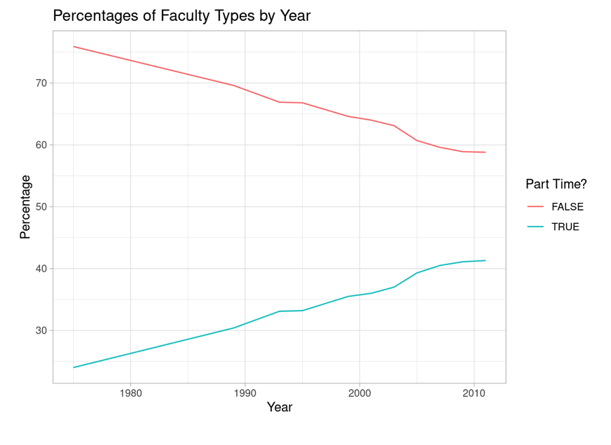
Data vis tips:
#1: Reduce cognitive load
#2: Label directly
#3: (Positional) encodings
#4: Salience matters
#5: Grouping matters

Slide 15
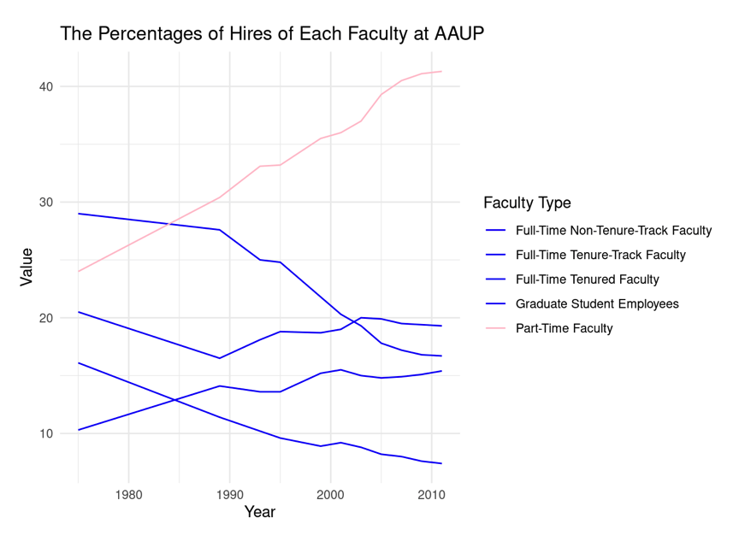
Data vis tips:
#1: Reduce cognitive load
#2: Label directly
#3: (Positional) encodings
#4: Salience matters
#5: Grouping matters

Slide 16
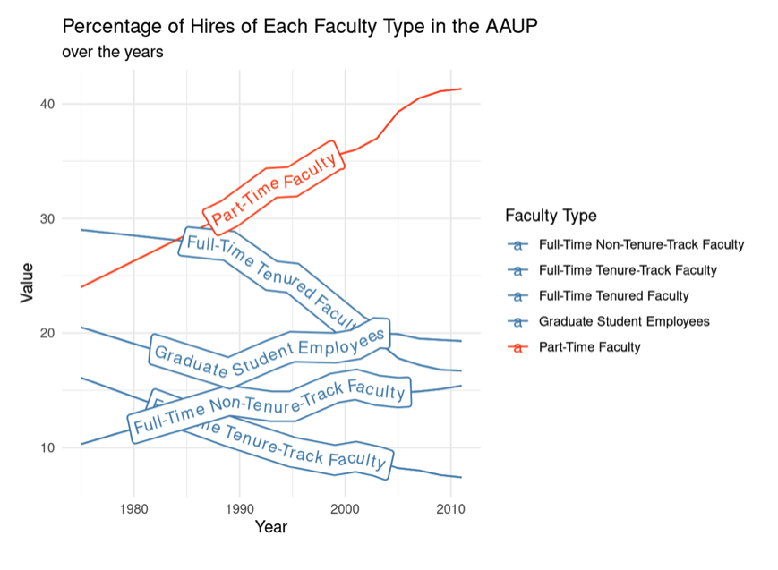
Data vis tips:
#1: Reduce cognitive load
#2: Label directly
#3: Positional encodings
#4: Salience matters
#5: Grouping matters

Slide 17
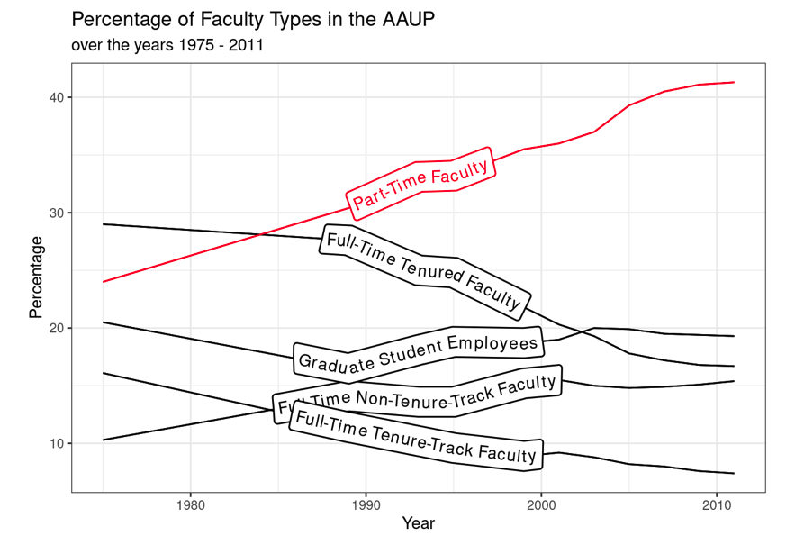
Data vis tips:
#1: Reduce cognitive load
#2: Label directly
#3: Positional encodings
#4: Salience matters
#5: Grouping matters
#6: Remove excess
#7: Informative text
#8: Highlight w/ color

Slide 18
Thanks!
Email: kfitzgerald@apu.edu
Twitter: @fitzgerald_kg
To learn more about data visualization best practices:
Franconeri, S. L., Padilla, L. M., Shah, P., Zacks, J. M., & Hullman, J. (2021). The Science of Visual Data Communication: What Works. Psychological Science.

Slide 19
Data Visualization Resources
New York Times: What’s Going On In This Graph?
from Data to Viz: https://www.data-to-viz.com
Information is Beautiful: https://informationisbeautiful.net
Gapminder: https://www.gapminder.org

